Slide 1
Application Lifecycle Management
Presentation by:- Md Wahidul Islam
Student Id: 20197VA

Slide 2
What is ALM/Quality Center?
HP ALM (Application Life Cycle Management) is a web-based tool that helps organizations to manage the application lifecycle right from project planning, requirements gathering, until Testing & deployment, which otherwise is a time-consuming task.
Gives you control over entire testing project.
It makes the task of mangers and testers easy by giving an easy interface to manage and organize activities such as requirements coverage , test case management, test execution reporting, defect management and test automation.

Slide 3
What is ALM/Quality Center?
This test management tool is now popularly known as Application Life Cycle Management Tool(ALM).
It is no longer just a test management tool, but it supports various phases of the software development life cycle such as-
Planning (initiation & requirements)
Design
Development
Integration & testing
Implementation (production)
Operations (maintenance & disposition)

Slide 4
History of QC/ALM
Quality Center was formerly known as Test Director, a product of mercury interactive.
1995-2003
Owned by – Mercury Interactive
Version 1.52 to Version 8.0
Commercial Name – Test Director
2004-2006
Owned By – Mercury Interactive
Version 8.0 to Version 9.0
Commercial Name – Mercury Quality Center

Slide 5
History of QC…cont.
2007 – 2009
Owned by – HP
Version 9.2 – Version 10.0
Commercial Name – HP Quality Center
2010 – 2019
Owned by – HP
Version 10.0 – Version 12
Commercial Name – HP ALM

Slide 6
HP ALM Editions
HP ALM is a commercially licensed tool and HP Distributes ALM in four different flavors. Each one of the licenses allows users to use certain ALM functions. Let’s see why you would purchase a particular version and whom it is suited for.
HP ALM ESSENTIALS
HP ALM ESSENTIALS
HP ALM ESSENTIALS
License
HP ALM ESSENTIALS

Slide 7
HP ALM Editions (Contd.)
HP ALM: This license is best fit for organizations that need complete access to all modules to support the entire development and test life cycle.
HP ALM Essentials: This is for corporations that need just the basic features for supporting their software lifecycle. It has access to requirement management, test management and defect management.

Slide 8
HP ALM Editions (Contd.)
HP QC Enterprise Edition: This license holds good for corporations who would like to use ALM exclusively for testing purposes. It also provides integration with unified functional tester
HP ALM Performance Center Edition: This license best suits organizations who would like to use HP ALM to drive Load Runner scripts. It helps user to maintain, manage, schedule, execute and monitor performance tasks.

Slide 9
Why use ALM?
There are various members involved in a project such as:
Developer
Tester
Business Analysts
Project Managers
Product Owners
There are certain set of activities which are preformed by each member which need to be communicated to other members of the team.

Slide 10
Developers
Version Control
Build Server
Test Case Management
Manual Testing
Load Testing
Automated Testing
Testers
Project Planning
Task Assignment
Bug Tracking
Project Managers
Business Analyst
Requirement Management QOS Management
Requirement Analysis
Product Owners
Portfolio Management
Stakeholder Communication

Slide 11
Why use ALM….cont.
It enables all the stakeholders to interact and coordinate, to achieve the project goals.
It provides robust tracking & reporting and seamless integration of various project related tasks.
It enables detailed project analysis and effective management.
ALM can connect to our email systems and send emails about any changes(like Requirement change, Defect raising, etc..) to all desired team members.

Slide 12
Why use ALM….cont.
In the past, before the Agile Manifesto was published and before organizations realized that their previous waterfall approach to software development was inefficient and prone to scope creep, cost overruns and missed deadlines, each of the disciplines that made up the overall software process was completely separate.
Once organizations realized how much more efficient, they can be having integrated teams that collaboratively define the requirements, plan the releases and sprints, test the product during development and deploy the latest update in a seamless way, the old separate processes didn’t make sense. ALM is basically the fusing together of the disciplines concerned with all aspects of the software delivery process:

Slide 13
Why use ALM….cont.
Instead of a set of business analysts working in a vacuum to define the vision and requirements, handing off the design to the developers, handing off the code to the testers, handing off the product to the IT support team to deploy and maintain, you now have a single ALM process spanning all these elements continuously delivering new features every X weeks. We now expect updates to our systems and apps continually rather than a major new release every 18 months.

Slide 14
How does ALM work?
ALM works under a domain. One project is assigned under a domain. ALM is a web based software management tool that has several capabilities. Such as:
Scheduling of test
Logging results
Progress tracking
Management and test reporting
Report analysis
Graphs

Slide 15
How to Download & Install HP ALM (Quality Center)
Before Installing ALM 12.55, one has to understand the system requirements. Users should meet all the below prerequisites for installing ALM Successfully.
Users should be installing ALM on one of the following Windows Server edition Operating Systems.
Microsoft Windows Server 2008 R2 Enterprise SP1 64 Bit
Microsoft Windows Server 2012 Standard 64 Bit.
One of the following Databases should have been installed before proceeding to installing ALM.
Oracle 10.2.0.5
Oracle 11.2.0.3
Microsoft SQL Server 2008 R2 SP2
Microsoft SQL Server 2012 SP1

Slide 16
How to Download & Install HP ALM (Quality Center)
User should use one of the following browsers to access ALM, after installation.
Microsoft Internet Explorer 8 32 Bit
Microsoft Internet Explorer 9 32 Bit
Microsoft Internet Explorer 10 32 Bit
To allow importing data from Excel/Word to ALM, users should have preinstalled one of the following MS Office Suites.
Microsoft Office 2010 SP2 32 Bit
Microsoft Office 2013 32 Bit

Slide 17
Modules of ALM
Requirements- requirements can be created, edited and deleted in this module. We can also map the requirements with the test cases
Test Plan- we can create manual as well as automated tests using WinRunner, QTP or LoadRunner in this module
Test Lab- In this module Tests (manual as well as automated) can be executed. During automated tests execution Quality Center launches the corresponding tool (Win Runner/QTP/Load Runner) and that tool executes the tests.
Defects- In this module testers can post defects and get status of their defects.

Slide 18
Requirements
Defining and Capturing Requirements is one of the key criteria’s for any software development process. Describing the requirements refers to what needs to be done to meet the objectives during development. It is very important that the requirements are clear and correct.
The Requirements module enables users to define, manage and track requirements at all stages of the software lifecycle.
Defining Requirements refers to what has to be delivered to the clients at the end of that specific release.
Establishing requirements with brevity and clarity upfront would result in minimal rework after development is completed.

Slide 19
Test Plan
The crucial step in testing any application is developing a clear and a precise test plan. A good test plan enables the team to assess the quality of the application under test at any point in the software development life cycle.
After defining requirements, development team kick starts their design and development process while Testing team start designing tests that can be executed once the build is deployed.
Success of any product depends on the testing processes and the quality of testing that is being carried out. A Good Test Plan results in a bug free product.
ALM supports maintenance and execution of manual, automation and performance tests as ALM is seamlessly integrated with all HP products such as HP UFT and HP Load Runner.

Slide 20
Test Lab
This module helps the testers to execute the created tests. One can schedule, run and analyze, test defects using this module
Once the test design is completed, test execution will take place with the help of Test Lab module.
One common term you will come across in HP ALM in the Test Set module of Test Lab. If your mind triggers images of some sort of collection or a set, you are correct. Test Set is in fact a collection of test cases that we intend to execute.
Test cases from the Test Plan module are called into the Test Lab module.

Slide 21
Test Lab (Contd.)
Changes done to test cases in the Test Lab module do not affect the parent test cases in Test Plan Module. You are free to experiment. Hence the name Test Lab!
It is better to give the test set name same as that of the module name so that all the tests within the module are contained in same test set which would be easy to execute and track.
Each test set folder is assigned to a particular cycle. This enables users to group the tests together that will be executed in a particular cycle.
This module also helps user to track the progress of the cycle as the tests are executed.
The Test Lab module consists of the following functionalities and let us understands each one of those in detail..

Slide 22
Defects
This module is the place where the tester starts logging or recording all the failed test case results (it could be any kinds of issues, problems or error message once a test case fails or even it could be a defect raised during ad-hoc, monkey or exploratory testing).
A Defect is logged during the test execution, when expected result and actual result don't match with each other.
Defect module in HP ALM not only helps users to post the defects but also enables them to track and gives the overall quality of the release at any stage of the development process.

Slide 23
Roles in ALM
Site Admin: Site Admin is the main person who can create the Project Admin and the users. He can do anything like create, update, delete etc.
Project Admin: Project manager is the Project Admin. He is assigned by the site admin for any individual project. He controls or owns project. A PA does not have the same privileges as Site Admin.
User: QA testers are assigned as user. They are like regular users. They have limited privileges. He can create certain things or do certain things that a PA gives him a permission to do. They are also responsible for creating test cases, test plans and execute the test, generating reports and retesting if needed.

Slide 24
As a Site Admin
In the administration area, the site administrator can do the following tasks:
Install Quality Center/ALM Software
Create a Domain and a Project
Activate the Project
Create Users for Quality Center/ALM and create their passwords
Assign the Users to the Projects
Delete a User
Make user a Site Admin
Make user a Project Admin

Slide 25
As a Site Admin
Below are examples of some configurations a site admin is able to do
Configured wait_before_disconnect features - For example: I configured the time interval
in minutes that the Test Director / Quality Center/ALM client can be inactive before it is
disconnected from the Test Director / Quality Center/ALM server. Disconnecting the client
enables the license to be used by another Test Director / Quality Center/ALM user. By
default, the value is set to 600 minutes. I set it for 60 minutes it means a user could maximum
be idle for 60 minutes. Note that if you set the value to –1, Test Director/Quality Center/ALM
will not disconnect, regardless of how long the client is inactive

Slide 26
As a Site Admin
Configured Mail Interval -ALM enables you to automatically notify users through email each time changes are made to specified defect fields. Site Admin can edit the mail interval parameter, which defines the time interval for sending defect emails in all projects.
Configured Mail Format - You can also set parameters to define the format and character set of mail, and whether attachments or history are included in the mail. By default, the format is set to "HTML". To instruct Quality Center/ALM to send e-mail as plain text, change the value to "Text".

Slide 27
AS A PROJECT ADMINISTRATOR
Change Passwords
Setup / Assign Users to the Project
Create New Users for a Project
Add Existing user to the project
Assign default Role / Privilege (TD Admin, Developer, Project Manager, QA Tester and Viewer) to the users.
Set-up Groups / Create New Group role like Test Manager, Business Analyst, Test Lead, Configuration Manager, Program Manager etc.

Slide 28
AS A PROJECT ADMINISTRATOR:
Change permission of the New Role
Add Users to the New Role
Customized Project Entities- Defect field customization i.e. making a field as a required field like making ‘Assigned to:’ field as required field
Making ‘Status’ field as required field and adding statuses like ‘Fixed- Ready For Retest’, ‘Deferred’, ‘In Development’, ‘Retest Passed’, ‘Retest Failed’, ‘Works As Designed’ etc.
Create new Project Lists – example - Test Environment (DEV, ALPHA, BETA, PROD, QUAL,UAT) in defect window.
Create new user field – example - Test Environment (DEV, ALPHA, BETA, PROD, QUAL, UAT) in defect window.
Create new Project Lists - example - Putting Issue Type (Defect, System Change Request, Suggestions/Comments) in the Defect section.

Slide 29
AS A PROJECT ADMINISTRATOR:
Create new user field – example - Putting Issue Type (Defect, System Change request, Suggestions/Comments) in the Defect section.
Adding new items in the Project Lists – example - add new sub-items in the Software item of Requirement Type field (Functional, Non-Functional, Software Change request, Performance and UAT) etc.

Slide 30
AS A PROJECT ADMINISTRATOR:
Set Traceability Notification/Alert Rules
Rule#1: When a requirement changes, notify the Designer(s) of the associated test(s).
Rule#2: When the status of a defect changes to ‘Fixed’, notify the Responsible Tester of the
associated test instance.
Rule#3: When a test runs successfully, notify those ‘Assigned to’ the associated defects.
Rule#4: When a requirement changes, notify the Designer(s) of the associated test(s) and all users.

Slide 31
As a User
A user has limited access to the project unless he/she is granted permissions by the project administer.

Slide 32
As a User
Change the Password
Create the Requirement folder in the Requirement section (Parent requirement)
Create Child Requirement folder in the Parent Requirement section
Enter Requirements in the Child Requirement folder
Install Excel Ad-ins
Prepare excel sheets for Requirements to export in the Requirement field

Slide 33
As a User
Export Requirement using Excel in the Requirement folder
Convert Requirements from the Requirement section to test in the Test Plan section
Develop Design Steps or Test Cases in the Test Plan section
Attach the Screen Shot / Documents for the steps, if necessary ,for instance- Test Data needed like user id, password, doc, gif, jpg, jpeg, pdf, png, txt, zip, rar, exe.

Slide 34
As a User
Create Template for the common steps
Call Template to the tests
Calling a manual test with parameters
Perform Requirement Coverage / Traceability or Linking Test to Requirement in the Test Plan section.
Prepare MS Excel sheets for design steps to export in the Test plan section

Slide 35
As a User
Export Design Steps to export in the Test Plan section
Create Test Sets in the Test Lab section
Import test cases in the Test Set
Execute Test Sets in the Test Lab section
Log Defect in the Test Lab section
Log Defect in the Defect section
Attach the Screen Shot as an attachment for the Defect

Slide 36
As a User
Attach the Screen Shot using snapshot for the Defect
Track / Filter Defect in the Defect section
Enter comments in the comment section after re-testing the Bug – for example – “Re- test passed recommending to close this Defect” or “Re-test Failed, recommending to Re-open the Defect.”
Bug Life Cycle
Generate Graph and Reports in the Requirement section

Slide 37
As a User
Generate Graph and Reports in the Test Plan section
Generate Graph and Reports in the Test Lab section
Generate Graph and Reports in the Defect section-copy the graph and use it in the TAR-Test Analysis Report document
Schedule automated test to execute or running automated test scripts in batch mode

Slide 38
ALM & Excel
Import Requirements and Test Steps to make life easy.
DO NOT highlight the first row! That criteria is built into ALM.
DO NOT leave any empty rows in between the lines. Excel Export will make you regret it.
MAKE SURE the folder name you’re working with matches with Excel.
Define the “Path” of the folder and requirements/test steps.

Slide 39
Bug vs Defect
Bug: A bug is an error/fault of the software which is detected in the development environment before the product is deployed.
Defect: A defect is the error/fault of the software which is detected after it is deployed in the production environment.

Slide 40
Bug Life Cycle
Bug life cycle is a cycle which a defect goes through during its lifetime. It starts when defect is
found and ends when a defect is closed, after ensuring it’s not reproduced.
Defect life cycle is related to the bug found during testing.
The defect life cycle can vary from organization to organization and also from project to project based on several factors like organization policy, software development model used (like Agile, Iterative), project timelines, team structure etc.

Slide 41
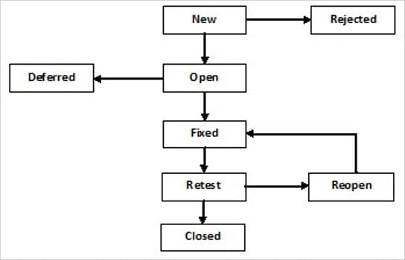
Stages of the Bug LifeCycle

Slide 42
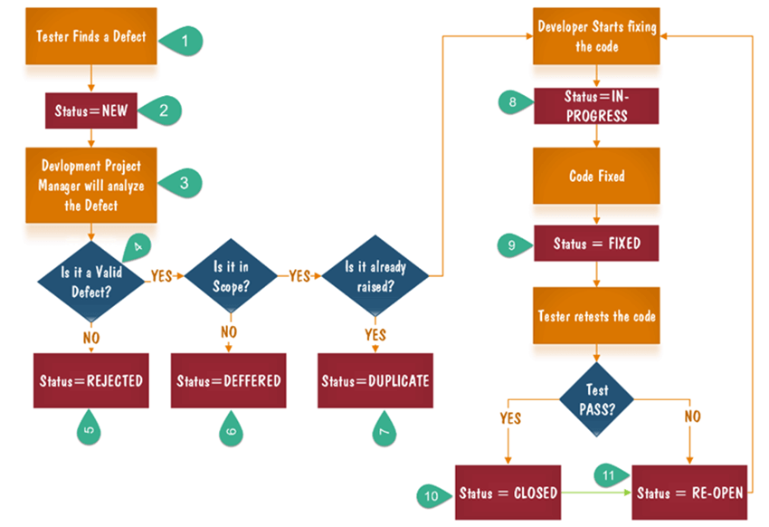
Defect Life Cycle Explained

Slide 43
Stages of the Bug Life Cycle
New : When a bug/defect is detected for the first time
Assign: After the tester has logged in or posted the defect, the lead of the tester approves that the bug is genuine and he assigns the bug to corresponding developer and the developer team. And changes its status to assigned.
Open: At this stage the developer has started to analyzing and working on the defect.

Slide 44
Stages of the Bug Life Cycle
After opening the defect/bug by the developer, he will do the following things:
A) Rejected: if the developer feels/sees that the bug is not genuine or he can not regenerate the bug in his environment, he rejects the bug and changes the status to rejected.
B) Deferred: the bug, changed to deffered state means the bug is expected to be fixed in next release. And this could happen for many factors, it might happen because the bug might have low impact on the application.
C) Fixed: when developer makes necessary code changes the he/she can make bug status as fixed and the bug is passed to the testing team again to retest.

Slide 45
Stages of the Bug Life Cycle
Verified: The tester retests the bug again after it got fixed by the developer. If the bug is not present in the software, the tester approves that the bug is fixed and changes its status to verified.
Reopen: If the bug/defect still exists even after the bug is fixed by the developer, the tester changes the status to “reopened”. The bug go through the life cycle again.
Closed: Once the bug is fixed, it is tested by tester again and if the tester can not reproduce the bug/defect in the application anymore. He changes the status to closed. The test lead closes the bug by changing the status ‘Closed’.

Slide 46
Stages of the Bug Life Cycle
If it is needed to Push the application to the Production and there are some cosmetic bugs still need to be fixed, the whole group (Project Manager, Team Lead, Testers, Developers, DBA, CM) decide to put the outstanding defects in the Deferred status and deploy the application in the production. After deploying the application in Production, developers fix the defects.

Slide 47
Defect Life Cycle
All defects found during testing the system are logged into the Test Director/QualityCenter/ALM Defect Tracking System.
The Testing Specialist/Tester or any one in the team logs the defect as soon as it is validated with developer, and assigns it to the Change Control Board (CCB) with a status of ‘Open’.
The CCB verifies the defect and then changes the Defect Status to one of the following after discussing with the person who logged it that is an invalid defect:
Rejected
Closed
As Designed
Cannot Reproduce
Closed As Designed
Closed Deferred
Closed Is Duplicate

Slide 48
Defect Life Cycle
For a valid defect, the CCB changes the Defect Status from ‘Open’ to ‘In Development’ and assigns it to the appropriate Developer with the proper priority.
The Developer verifies the defect; changes the Defect Status from ‘Open’ to ‘Rejected’ for an invalid defect and assigns it to the CCB with appropriate comments.
For a valid defect, the developer works on fixing the issue.

Slide 49
Defect Life Cycle
When the developer is done addressing the defect, she/he assigns it to the Development Lead as ‘Fixed’.
The Development Lead verifies the fixing and re-assigns it to the Testing Specialist/Tester as ‘Ready for Retest’.
The Testing Specialist/Tester verifies that the defect was properly addressed and assigns it the CCB.
The CCB confirms the fixed and assigns it to the appropriate Closed or Failed category.

Slide 50
Thank you
That is all I have for my session today!
Thank you for joining!

